Slide 1
HTML Tables
Matthew Phillips

Slide 2

Definition and Purpose
Their Job: To organize tabular data into a grid of rows and columns
Usage: Spreadsheets, price lists, statistics, or schedules
The Right Tool: Use CSS (Flexbox & Grid) for layout. This is crucial for accessibility and responsive design

Slide 3
Key Terms and Elements
Key Terms:
<table>: This element is used to wrap everything in the table together
<tr> table row: This tag creates horizontal rows in your table
<td> table data: This is where you put the information of the table
<th> table head: This is used for the titles of your columns and rows
<caption>: This provides a description to tell what the tables representing
<colspan>: It tells that cell how many columns it should stretch horizontally
Notes:
There is a lot of things I had to put down so this slides the most full

Slide 4
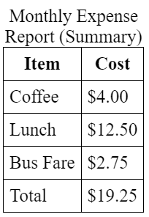

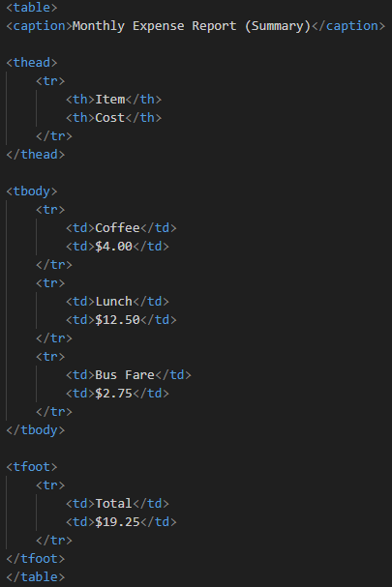
Visual Example
This is a basic table structure to display a monthly expense report
It shows what categories they are by name, the item, the cost of that item, and the total at the bottom
Notes:
The table used isn’t an actual table from somewhere

Slide 5
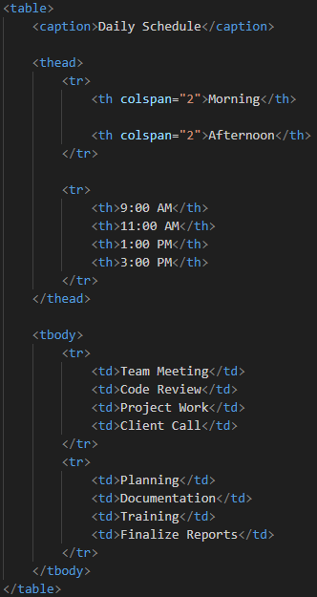

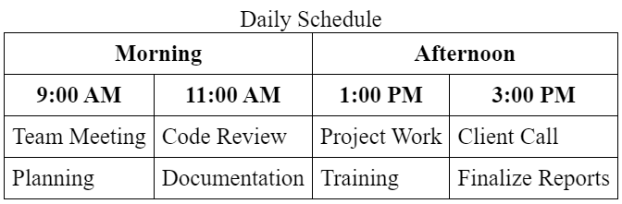
Applied Example
This is another basic example that uses colspan
The difference is colspan is used because there is a two-row header, allowing for more customization and cleaner outputs

Slide 6
Common Mistakes and Tips
A common mistake is using tables for page layout
Instead, you should use either CSS Grid or Flexbox
Some tips are to always use <th> for table headers instead of <td>, prioritize accessibility, and style it with CSS, not with old HTML
Notes:
The <th> tip is because using <th> isn’t required, but helps accessibility a lot

Slide 7
Key Takeaways
Tables provide essential structure for data, aligning with data organization
The core elements are <table>, <caption>, <tr, <th>, <td>, and <colspan>
All styling, from fonts to borders, must be handled with CSS
You can use HTML tables for displaying tabular data (like spreadsheets, schedules, or statistics) because they structure that information into an accessible grid of rows and columns.

